Slide 1
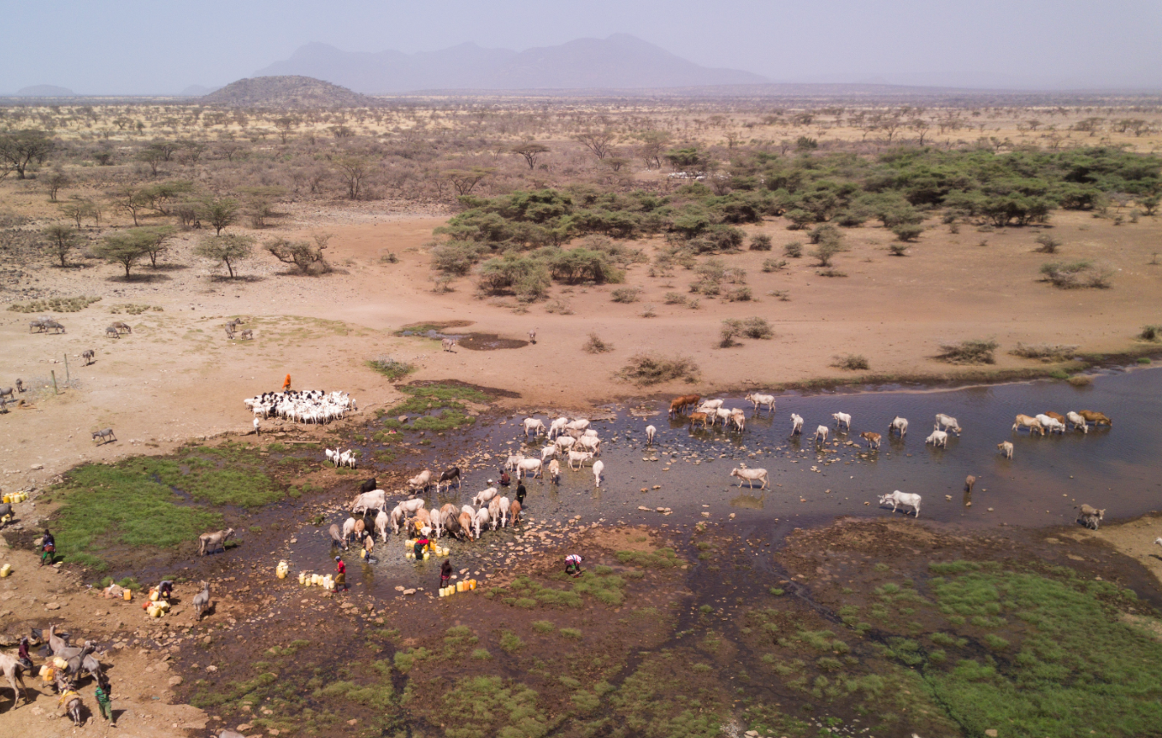
Sustainable land management practises for the GGW
UNCCD COP15 - GGW Day, 18. May 2020
Tatenda Lemann, WOCAT Executive Team, Centre for Development and Environment, University of Bern, Switzerland
Photo: Hanspeter Liniger

Slide 2
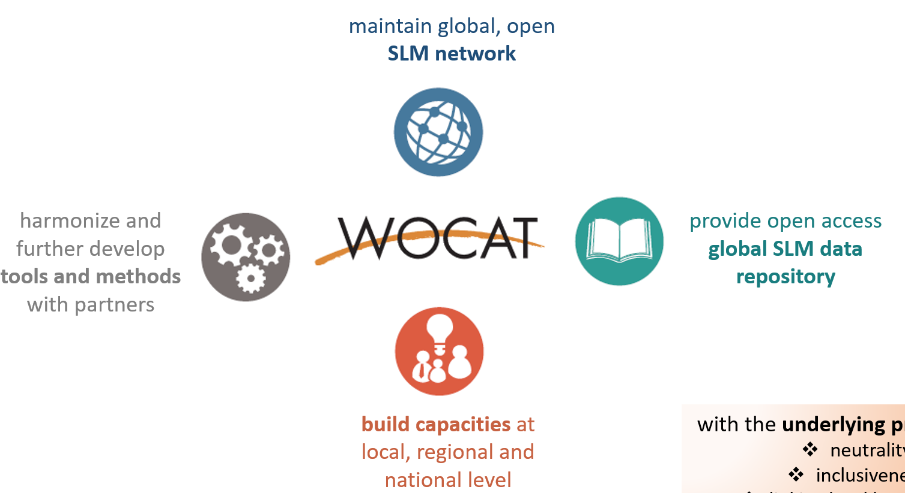
What is WOCAT?
Over the past 30 years, WOCAT and its partners have developed a set of standardized tools and methods for SLM knowledge management and decision support. These are now used in over 50 countries around the globe.
WOCAT supports innovation and decision-making in SLM through four pillars:
2014: UNCCD selects WOCAT as the primary recommended database for SLM best practices and adaptation measures
Notes:
The World Overview of Conservation Approaches and Technologies (WOCAT) is a global Network established in 1992.

Slide 3
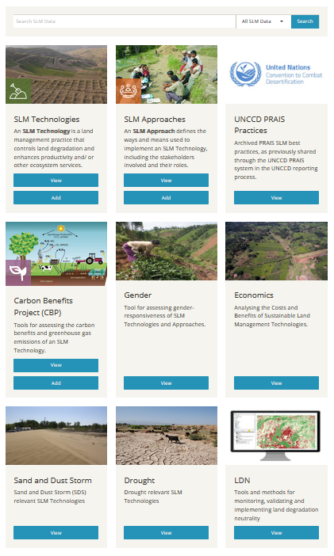
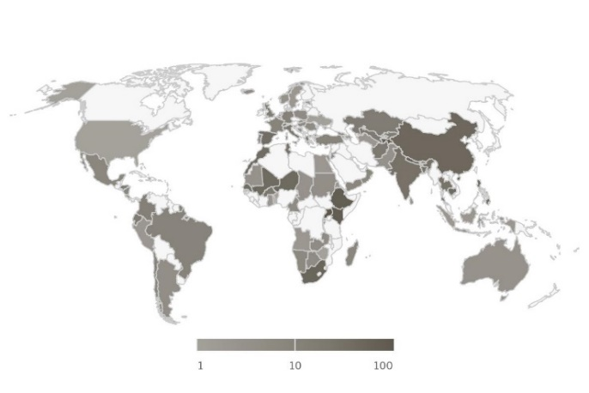
WOCAT Global SLM Database
2000+ proven, field-tested SLM practices from 133 countries that can be freely consulted in the design of landscape/SLM interventions
Database filter helps to find relevant SLM practices for specific landscapes, land uses, ecosystems
Lessons learned and good practices from projects and programmes can be freely uploaded and shared worldwide
Database can be interlinked with national/project and global platforms (through API)
Visitor Map
Documentation Map

Slide 4
SLM good practices from the GGW intervention zones
Country | TECH | APRCH
Burkina Faso | 17 | 4
Chad | 2 | 2
Djibouti | - | -
Eritrea | 2 | -
Ethiopia | 59 | 25
Mali | 21 | 20
Mauritania | 2 | 1
Niger | 32 | 13
Nigeria | - | -
Senegal | 32 | -
Sudan | 2 | 2
Total | 169 | 67
Notes:
236

Slide 5
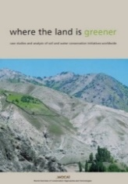
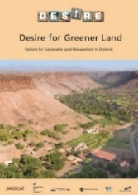
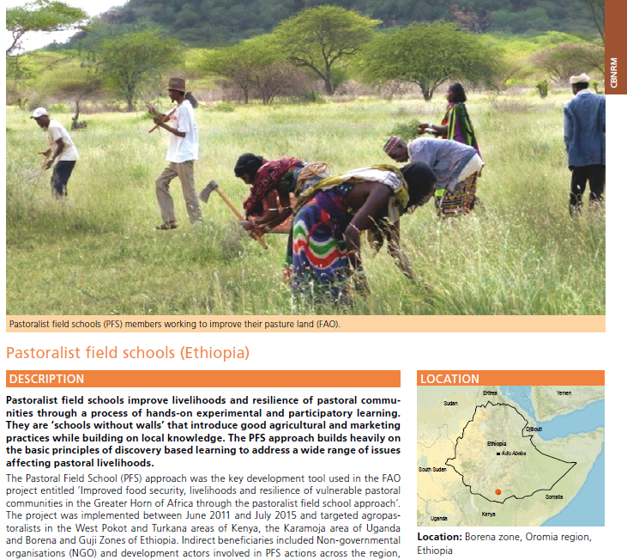
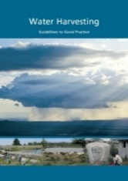
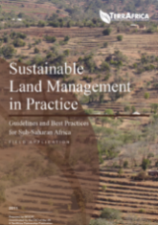
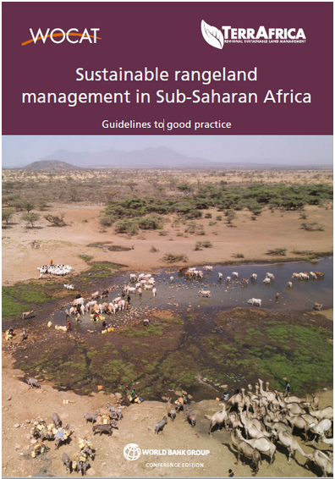
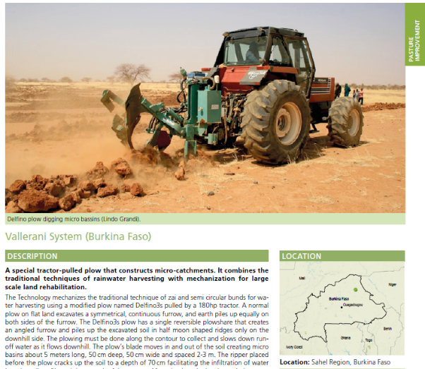
SLM good practices from the GGW intervention zones

Slide 6
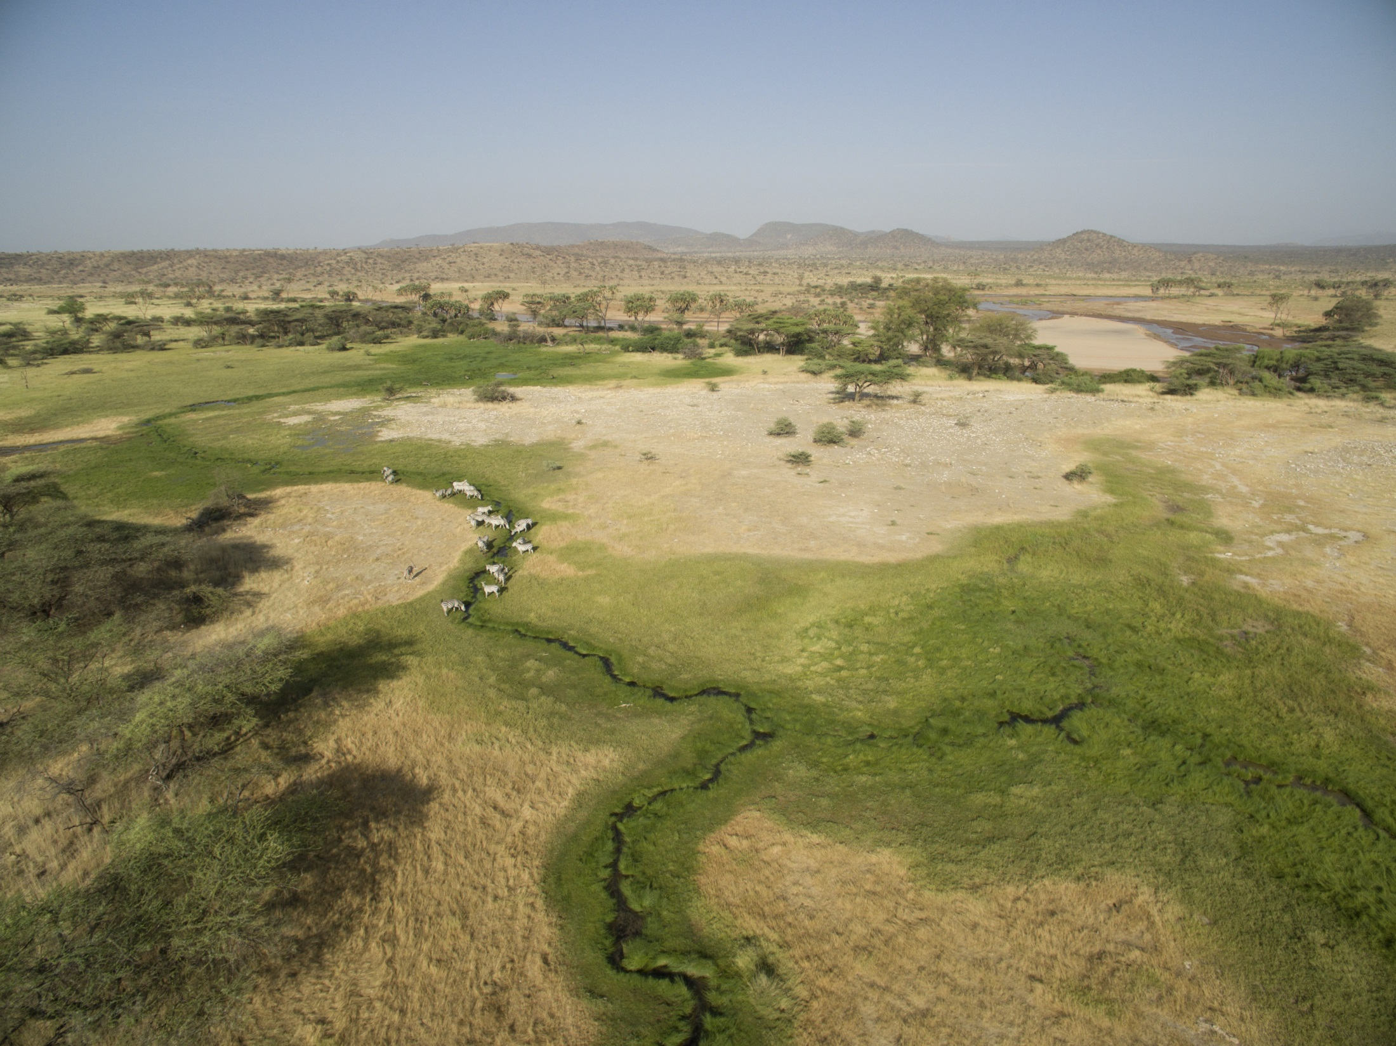
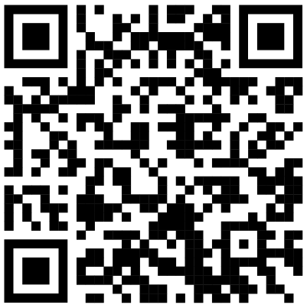
Contact us:
www.wocat.net
wocat.cde@unibe.ch
@WOCATnet
@wocatnet
Photo: Hanspeter Liniger

